Slide 1
Trading & Risk Management
Risk Management Software Packages

Slide 2
Risk Management Software Process
DATA
ANALYTICS
REPORTS
Market Data Capture
Forward Curves
Volatility Curves
Volatility Smile
Market Data Analytics
Forward Curve Manipulation
Volatility Interpolation
Trade Reports
Position
Mark-to-Market
Profit-Loss
VaR &CFaR
Greeks
Counterparty Exposure
Deal Capture
Counterparty
Delivery Terms
Price
Quantity
Deal Analytics
Option Pricing Models
Tracking Trade Maturities
Corelations
Back Office FAS and IAS Accounting
Acctg Reports
Invoicing / Settlement
FAS 133 Journal Reports
Trade Audit Reports
Trade Approval

Slide 3
Market Data

Slide 4
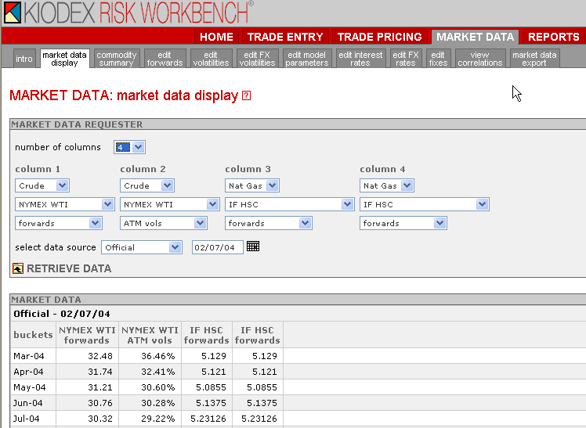
Market Data Capture Data Display

Slide 5
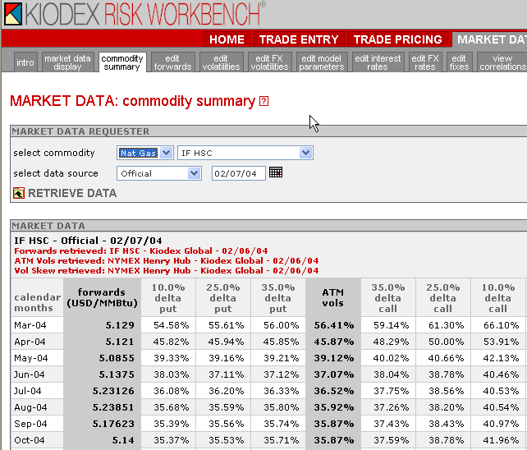
Market Data Capture Commodity Summary
At-the-money
Volatility

Slide 6
Forward Curve & Volatility Shapes
Price & Volatility
Out-of-the-money Volatility Smile
Sample
Forward
Curve
Sample ATM
Volatility
Curve
Time

Slide 7
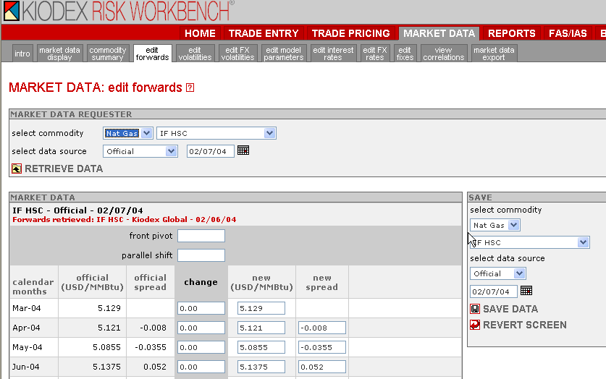
Market Data Capture Editing Forwards & Volatility Data
Systems usually
have multiple curve
saving capabilities
Viewing Specific futures
contracts or the spot
price for a location
Analytics for changing
curve shapes

Slide 8
Shifting the Forward Curve
Forward
Prices
Original
Curve
Parallel Shift
in Prices
Front-month Shift
in the forward curve
Time

Slide 9
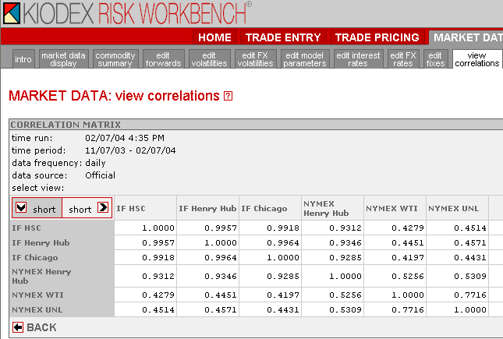
Market Data Capture Correlation: Short-Short

Slide 10
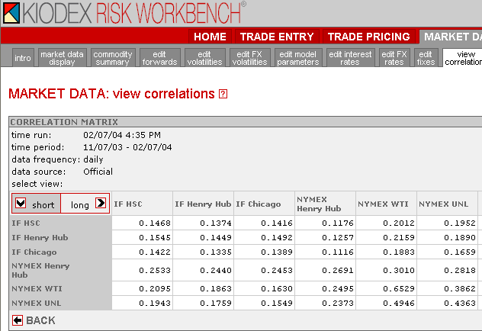
Market Data Capture Correlation: Short - Long
These correlations are
used to determine how
the prompt-month and
Tail-month respond to
each other (Slide 7)
Last Month in
The Forward Curve
(e.g. 5 years from now)
Prompt Month

Slide 11
Trade Pricing

Slide 12
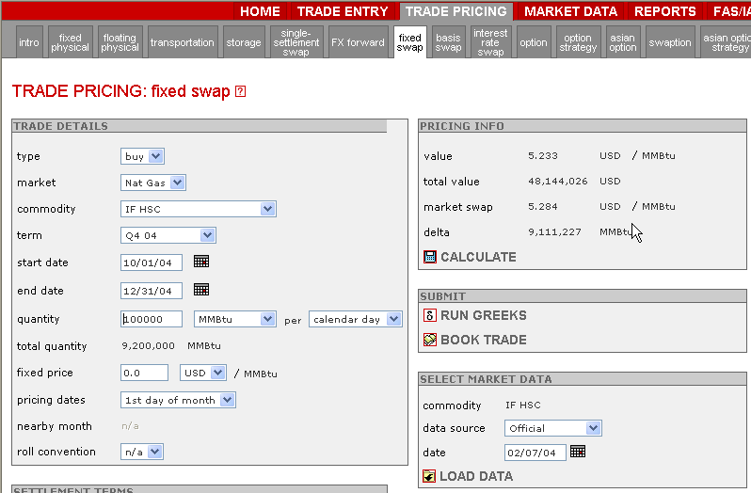
Trade Pricing “Fixed for Float” Price Swap
Is this trade for a Producer or Consumer?
Expected Unhedged
Revenue/Cost Value
Discounted Average
Swap Price
Average
Swap Price
Use a price of $0 for
natural positions.

Slide 13
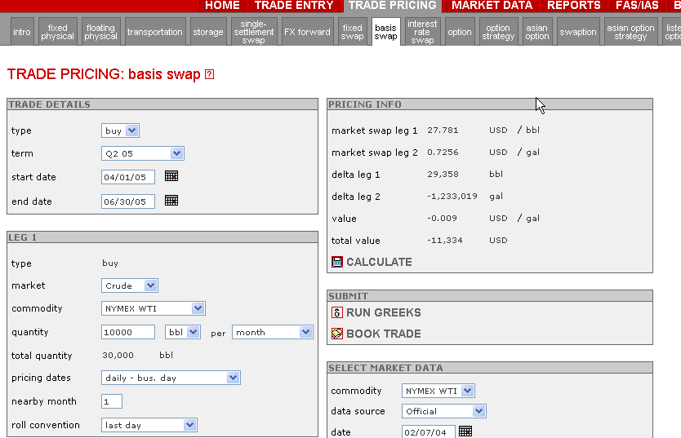
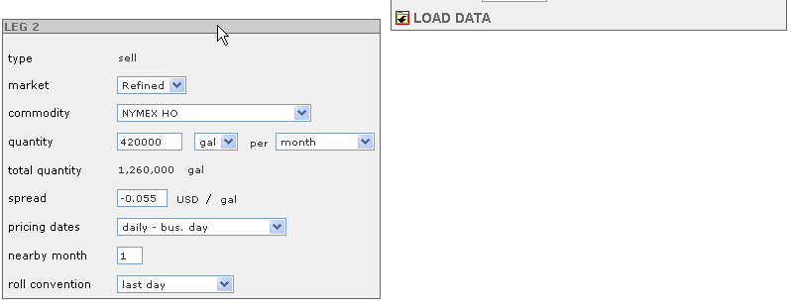
Trade Pricing Commodity Spread Swap: Buy Crude / Sell HO
Is transaction Speculative
or a Hedge?
Profit?
(0.7256 –27.78142)-0.055
=0.00914 / gal.
Trade enables purchaser to
“lock-in” a financial
“fixed-for-float” swap
in which the holder is
guaranteed to be able to sell
heating oil for a fixed conversion
ratio based on crude oil prices.
If you were to have changed your forward
curve data in Market Data, you could analyze
the trade using the “User 1” or “User 2”
forward curve.

Slide 14
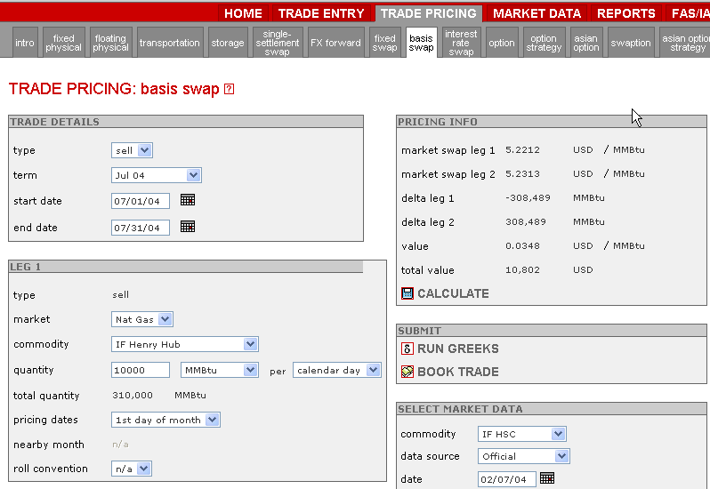
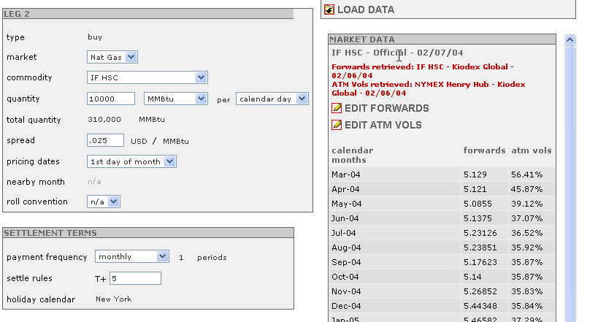
Trade Pricing Location Spread Swap: IF HSC / IF HH
This trade locks the price differential between IF Henry Hub and IF Houston Ship Channel. If a producer preferred the volatility at HSC over HH, they could “swap” the price risk between the two. In this case, the producer would accept the price risk at HSC instead of HH.
Click here to shift or alter your forward
curves and volatilities and save using the
“User 1” or “User 2” forward curve.

Slide 15
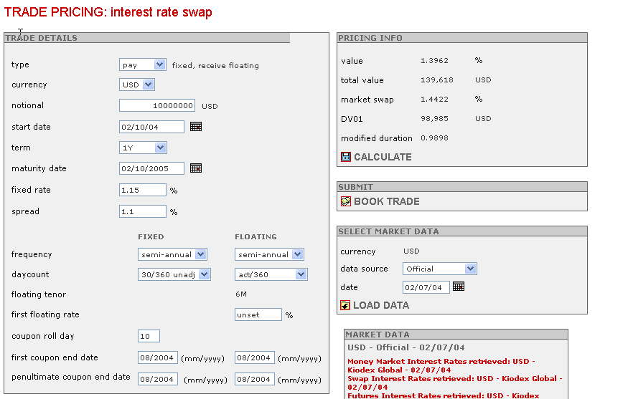
Interest Rate Swap Fixed-for-Float

Slide 16
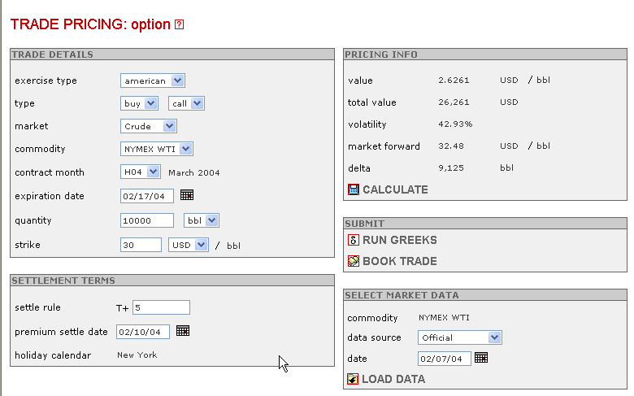
Option on Futures
The current March crude price is $32.48. Would you pay $2.63/bbl. to cap the crude price at $30? Are you in-the-money or out-of-the-money?
American and European options are usually used for futures contracts. Note: Single-month contract notation
Greeks are the derivatives of a trade or a portfolio (e.g. how does the option value change if the crude price moves 1$)
Settle Dates are different for each commodity

Slide 17
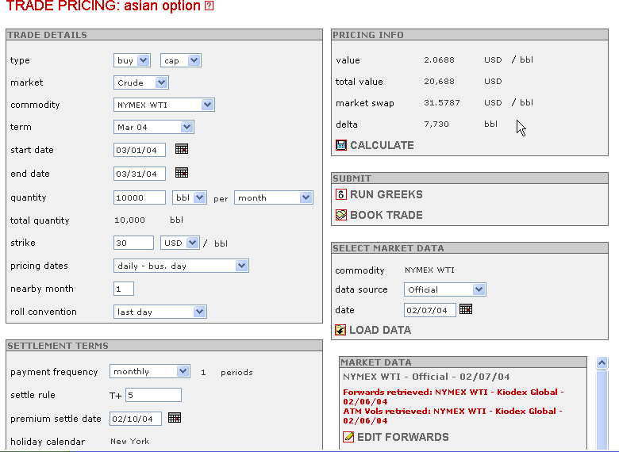
Asian Option on Forward
Note: Volatility is 35.46%. The option price is $2.0688. Is there an arbitrage between the American and European options? Why the difference in option price and volatility between Asian and Euro/American options.
You can transfer data to book all trades but collars by clicking this button.

Slide 18
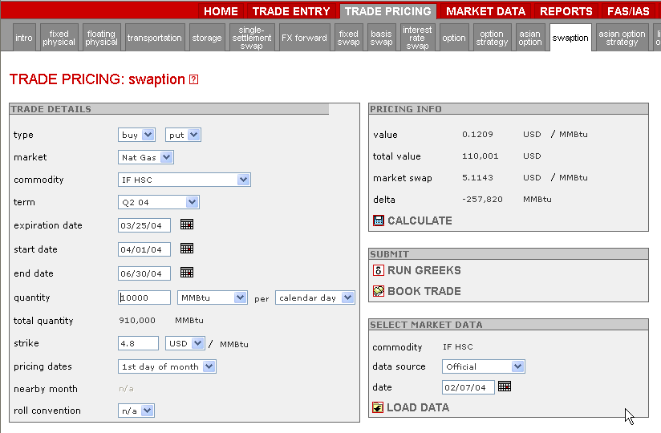
Swaption: Option on a Swap
Date the option expires
Note: Compare values of European / American Option, Asian option and Swaption. What are the differences between the three options?
If the forward price is below the strike on the expiration date, the holder will exercise the put option
Fixed Price Swap Term

Slide 19
Option Types
European/American Options:
An Option is a contract which gives the holder the right, but not the obligation, to purchase or to sell an underlying asset at a specified price (the exercise, or "strike," price) within a specified period of time in exchange for a one-time premium payment.
An American Option is exercisable at any time before or on its expiration date.
A European Option contract is similar, except for the fact that it can only be exercised on its expiration date.
Both types of option contracts reference a single futures contract price on that date.
Options can be either physically or financially settled.

Slide 20
Option Types
Asian Option:
An Asian Option is a path-dependent option
Payout depends on the average price of the underlying instrument during the averaging period of the option.
The averaging is calculated with reference to the nearby month, pricing dates, start dates, and end dates.
An Asian Option is a purely financial agreement, rather than an option to exchange physical goods.
The option seller settles his or her contractual obligation by cash transfers either at expiration or at pre-set time intervals during the life of the option.
An Asian Option automatically exercises if it is in the money at expiration.
The option seller pays to the option buyer the difference between the strike price and the floating price, multiplied by the quantity for that averaging period.

Slide 21
Swaption
A "swaption" is an option on a fixed price swap.
The buyer of the swaption has the right, but not the obligation to enter into a fixed vs floating commodity swap with a fixed price equal to the strike of the swaption.
To receive this right, the buyer pays an upfront premium.
A "call" swaption gives the buyer the right to buy a fixed swap
The buyer pays fixed and receive floating.
The buyer would exercise the swaption if the forward swap price were higher than the strike on the swaption expiration date.
A "put" swaption gives the buyer the right to sell a fixed swap
that is receive fixed and pay floating.
The buyer would exercise the swaption if the forward swap price were lower than the strike on the swaption expiration date.

Slide 22
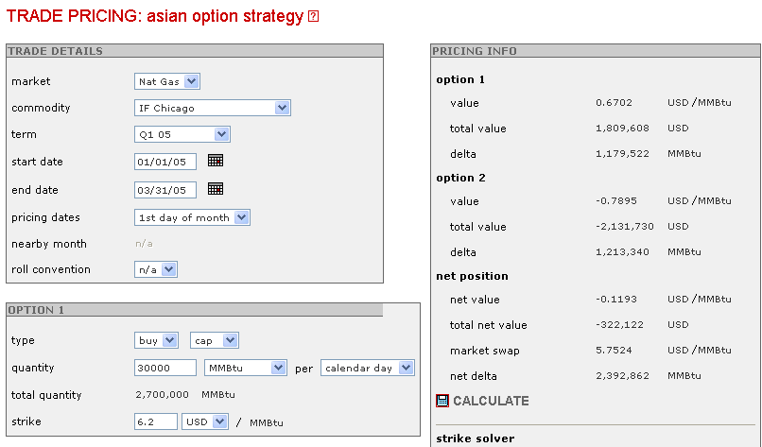
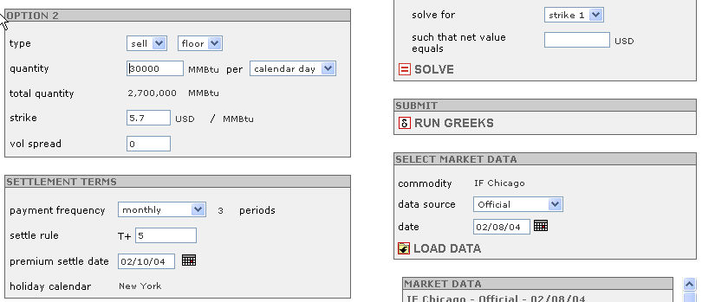
Pricing a Collar
The cap value
The floor value
The net position
The vol. spread is a method for a broker to add a premium. We will cover this later in the chapter

Slide 23
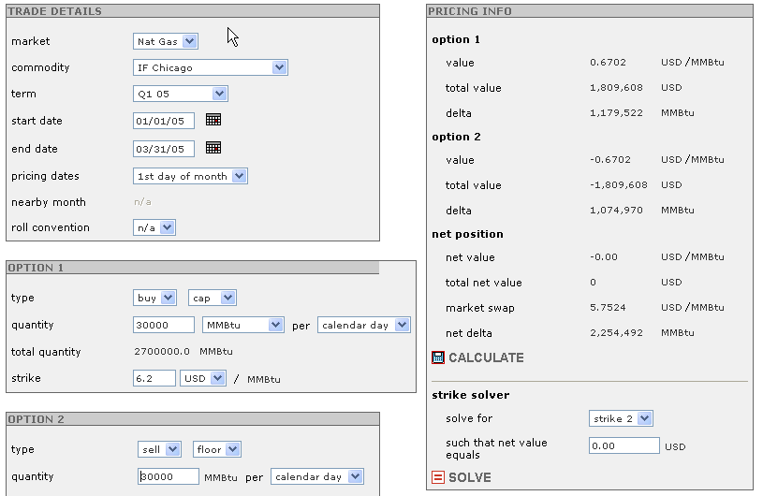
Pricing a Costless Collar
E.g. if you want a cost-less collar and want the cap set, use the solver to iterate into the floor price.
The strike solver solves for a particular strike when the net payout and the other strike are set.
The present value of the collar price is net zero.

Slide 24
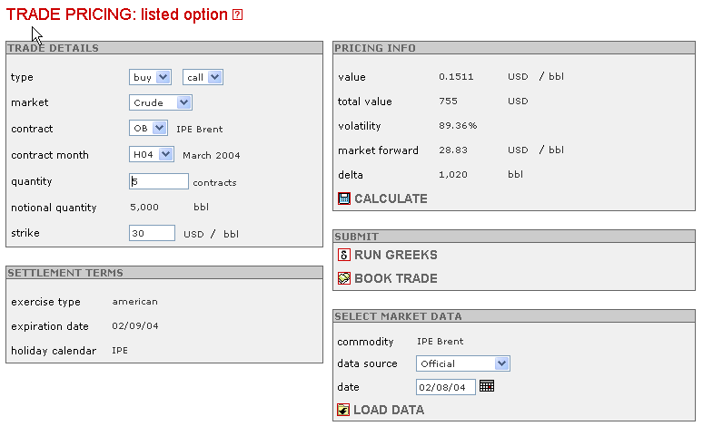
Option on a Listed Futures
Option is on exchange contracts instead of crude barrels
Is option in the money or out of the money?
American Option

Slide 25
Trade Booking

Slide 26
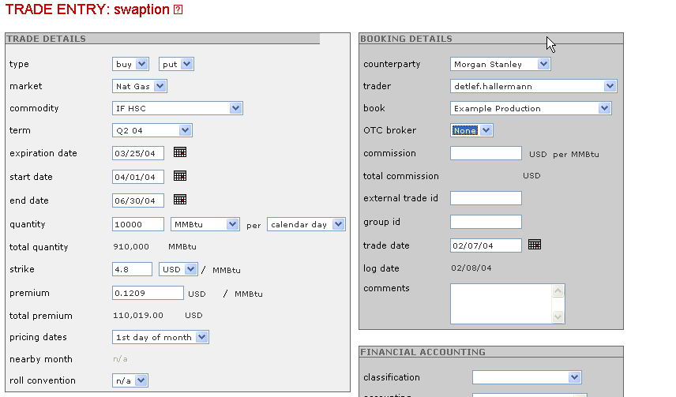
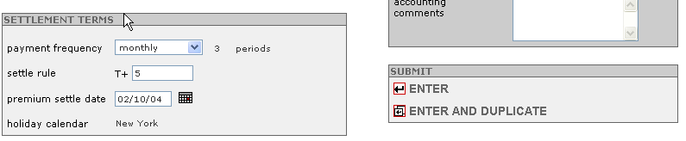
Booking a Trade
Counterparty, Trader, Book & Broker Info are all set up in Administration. MAKE SURE YOU HAVE THESE SET UP FIRST.
FAS 133 Hedging Documentation
Very useful when entering multiple trades that are very similar (e.g. collar or successive month trade with different swap or strike prices

Slide 27
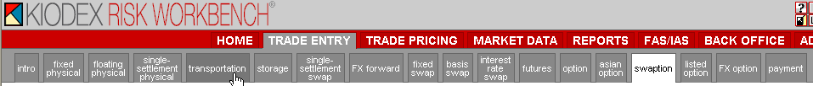
Trade Types
Do not worry about these types of trades
Futures contracts have no analytics associated with pricing them, thus they are only on the Trade Entry Screen
Payments are used to reconcile option premium payments and contract settlements

Slide 28
Reports

Slide 29
Trading Risk Reports
Reports
Position Report
Mark-to-Market Report
Profit/Loss Report
Settlement Report
Financial Reports
Inventory Report
Balance Sheet
Income Statement
Statement of Cash Flows

Slide 30
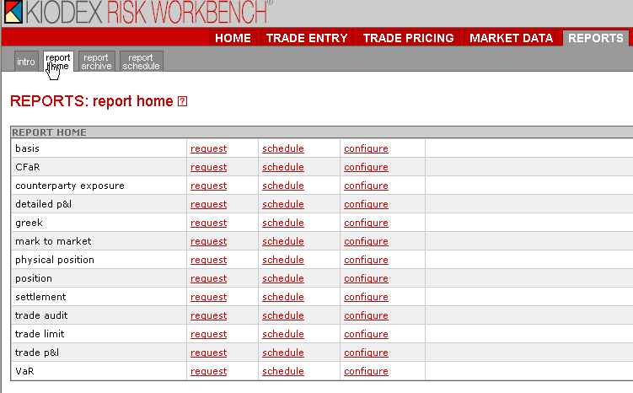
Risk Reports

Slide 31
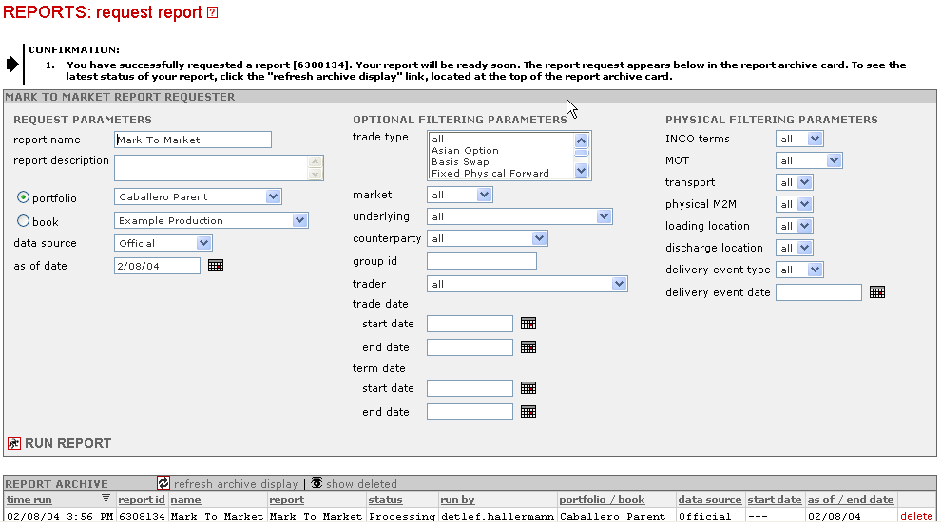
Requesting Reports
As of Date can be any time in the past to present
Financial and Physical Filtering Parameters
All reports are kept on the server “ad infinitum”. Thus, if there are group of reports that you have deleted, you can recover them by clicking here.
Reports are run on servers over the web. Hitting F5 will not update the screen. To see if your report is ready, click on:
…or hide reports by clicking here

Slide 32
Risk Reporting
FINC 689

Slide 33
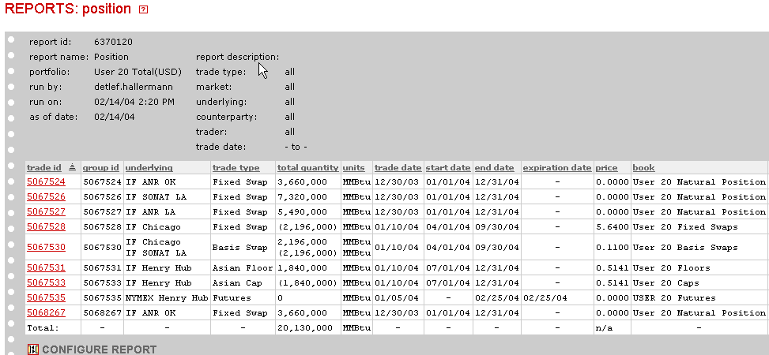
Position Report
Extra Position
Net Long/Short

Slide 34
Position Swap Diagram
ANR OK
Chicago
ANR LA
SONAT Basis
SONAT
Asian Cap
Net Long/Short
Chicago Basis
Asian Floor
Net: 17,470,000 mmBTU Long

Slide 35
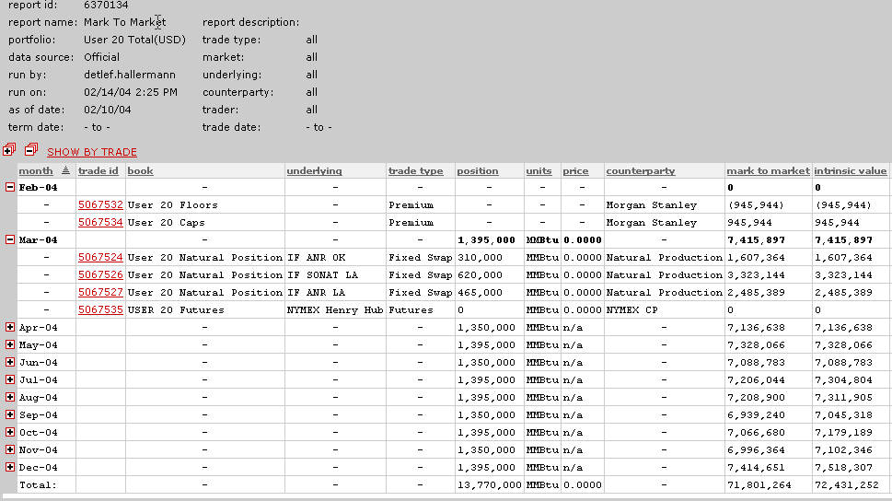
Mark-to-Market Report
Position Coincides
with Position Report
Total Mark-to-Market

Slide 36
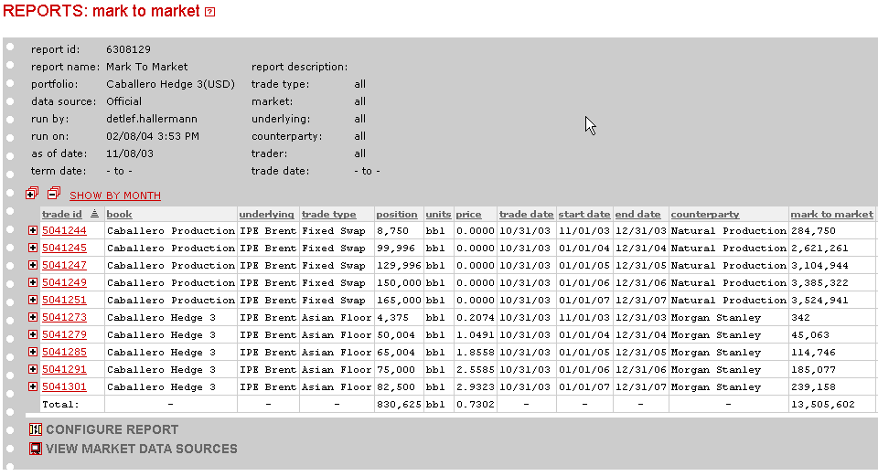
Example MtM Report (by transaction)
Notice the “as of date”
No Physical or Financial filters used
Natural Production or Consumption has a swap price of $0
Portfolio MtM value
Configure Reports to Personal Liking
Portfolio is a mix of natural production and Asian floors (puts or calls?). How much of the portfolio is hedged?

Slide 37
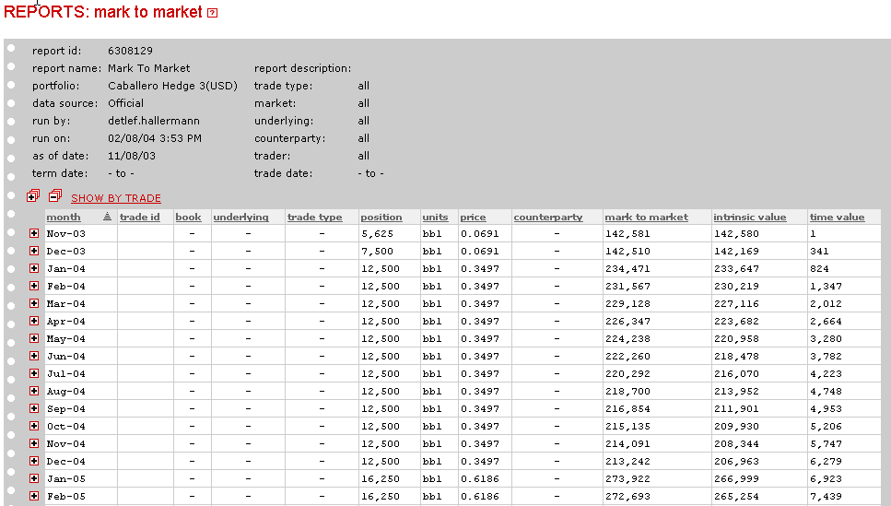
Example MtM Report (by month)
A portion of the same report. Positions are grouped by month instead of by transaction

Slide 38
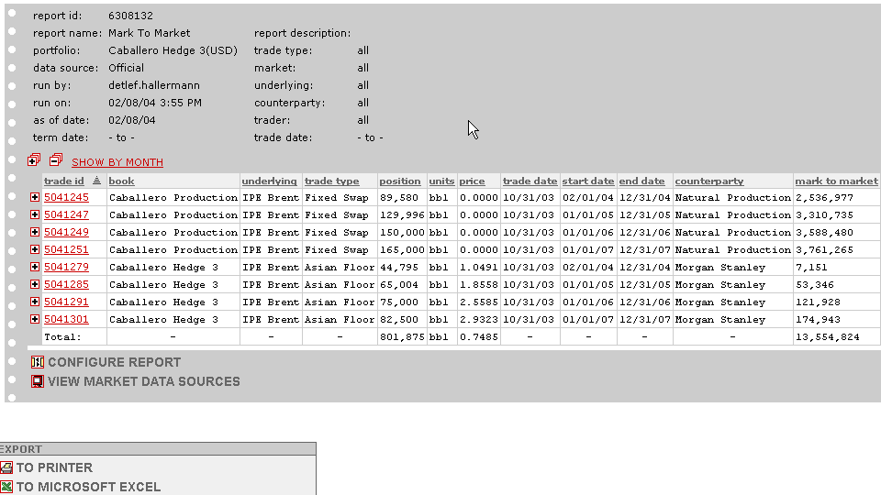
MtM Report two months later
Why are there less positions than two months ago? Why the change in MtM value?

Slide 39
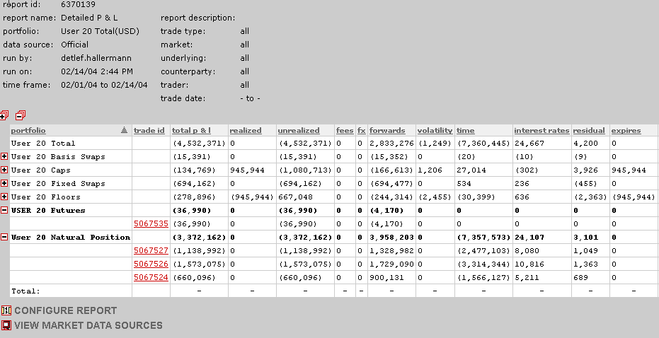
Profit/ Loss Report
Bad Time Period for Trading
Shows where & how you made/lost money
Compare Long & Short Positions: Did you gain on every short position
and lose on every long position?

Slide 40
P/L Reports
Trade P&L report The Trade P&L report examines different elements of profit & loss (P&L) for the hedging and trading activities of an organization over a specified time period. The report shows the P&L of each trade from its inception date. It breaks out the P&L into outstanding mark to market, premium, settled and paid, and settled not paid components.
Detailed P&L report The Detailed P&L report examines different elements of profit & loss (P&L) for the hedging and trading activities of an organization over a specified time period. The report breaks down P&L into realized and unrealized gains or losses from different market forces, including changes in volatility, movements in prices (forwards), and changes in foreign exchange rates.

Slide 41
Profit/Loss Report
Balance Sheet (t=1) – Balance Sheet (t=0) =
Income Statement
MtM Report (t=1) – MtM Report (t=0) = Profit/Loss Statement
Class Exercise:
Run your portfolio Mark-to-Market reports for 2/9 and 2/10. Run the Daily Detailed P/L Report for between 9/10 and 9/9. Subtract the two MtM reports and compare to the P?L report.

Slide 42
Does MTM Relate to Income?
When you calculate the P/L value of your entire portfolio, the end result is not revenue or net income.
The P/L of a portfolio is Gross Margin.
Gross margin = Revenue – Cost of Goods Sold
To convert P/L value to earnings, you would have to subtract out interest, taxes, depreciation, etc.

Slide 43
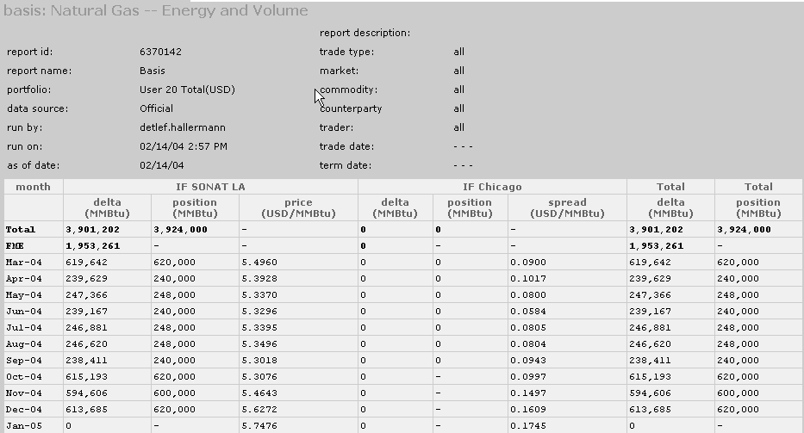
Basis Report
Net Position (net of Basis Swaps)
Base Location (Designated in the Report)
Price Spread between Locations
Delta will be explained in Greeks
Position is open position
In relation to SONAT LA

Slide 44
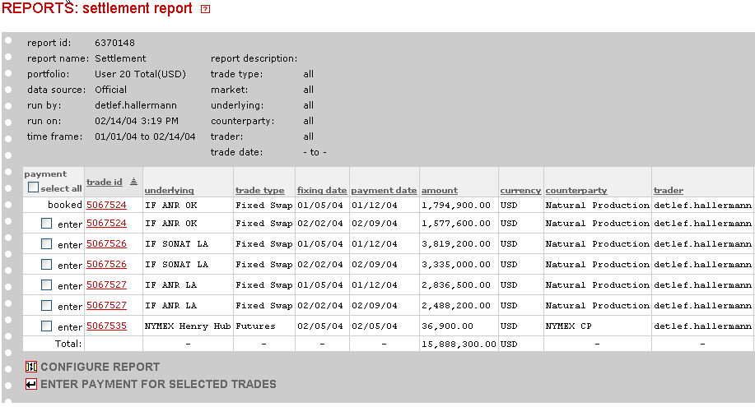
Settlement Report
Trade Booked & Settled
Most of the trades require settlement
Back-Office Report for
confirming payments

Slide 45
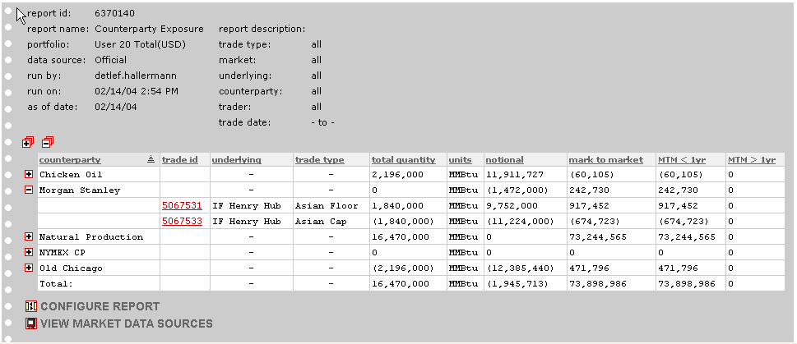
Counterparty Exposure Report

Slide 46
Credit Risk and Financial Liquidity
From a MtM perspective – clear relationship between credit risk and financial liquidity
Underlying price process drives the distribution – collateral mitigates credit risk
Financial
Liquidity
Risk
Credit
Risk
Negative MtM
0
Positive MtM

Slide 47
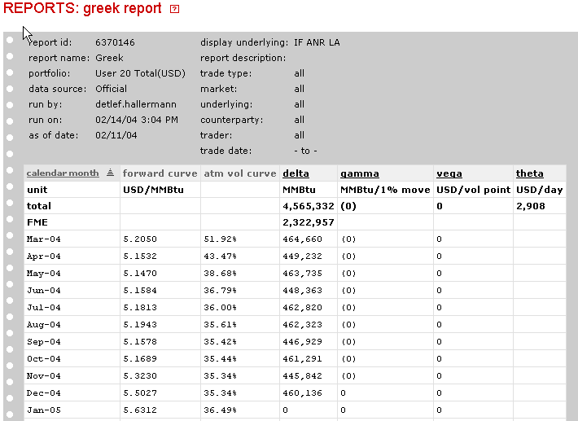
Greek Report
We will cover Greeks in detail next week.

Slide 48
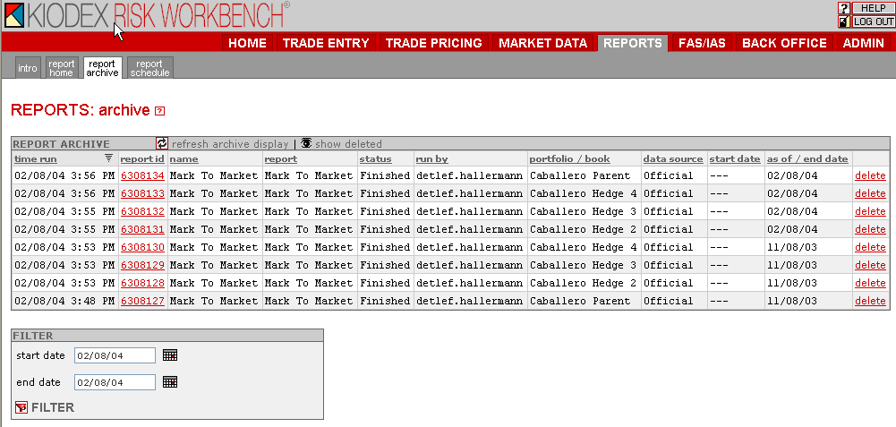
Report Archive
A good risk management system should let you recover old reports as well as rerun reports for a particular time period. This is critical for audit purposes.

Slide 49
Sample Deal Life Cycles

Slide 50
Deal Life Cycle – OTC Power
Deal Execution Day 1
Credit Exposure Report
Trader executes deal with existing counterparty
Trader completes deal ticket
Middle office inputs deal into RMS
Logistics contacts counterparty to schedule power or net-out
End-of-day Daily Summary Report reviewed by Trader & Mid-Office to verify & validate deals
Confirmation group determines proper confirm template to use
Confirm prepared and send to counterparty
Position Report / Trading Limits
Deal risks become part of trading portfolio and managed by Front Office
Deal incorporated into Daily Position and P&L Reports generated by Mid-Office
Confirm group monitors for execution status
File deal ticket

Slide 51
Deal Life Cycle – OTC Power
Month-End
Settlements ensures deal terms have been actualized in system
Settlements prepares invoice or payment and sends to counterparty
Settlements ensures G/L entries related to deal are accurate and booked properly
If sale, settlements monitors A/R aging to ensure timely cash receipt

Slide 52
Deal Life Cycle – Structured Gas
Contract Execution
Corp. Strategy & Objectives
Origination communicates deal terms and contract draft via DASH to applicable internal groups for their review
Internal groups review and approve deal
Origination group negotiates deal with counterparty
Origination works with Legal and Credit to draft contract
Contract executed with counterparty
Middle Office books deal into RMS
Structuring assesses deal risks and develops initial valuation and structure
Middle Office reviews and validates deal valuation and risk components
Counterparty and contract information input into database by Contract Admin.
Deal incorporated into Daily Position and P&L Reports generated by Middle Office
Contract filed

Slide 53
Deal Life Cycle – Structured Gas
Contract Execution thru Contract End Date
Contract Start thru End Date
Contract Admin monitors counterparty and internal contract compliance
Settlements ensures deal data has been actualized in system
Settlements prepares invoice or payment and sends to counterparty
Settlements ensures G/L entries related to deal are accurate and booked properly
Trading manages deal risks in trading portfolio
Logistics coordinates scheduling activities with counterparty
If Sale, Settlements monitors A/R aging to ensure timely cash receipt

Slide 54
Deal Cycle – CME Exchange
Deal Execution Day 1
Position report / trading limits
Trader executes deal through a broker
Trader completes deal ticket
Front Office verbally ties out with broker at end-of-day to verify and validate deal
Middle Office inputs deal into RMS
File deal ticket
Deal risks become part of trading portfolio and managed by Front Office

Slide 55
Deal Cycle – Nymex Exchange
Deal Execution Day 2
Month-End
Middle Office reviews broker statement for previous day’s trading to verify and validate deal
Middle Office or Credit reviews broker statement for margin adjustments to determine reasonableness
Daily margin activity communicated to Treasury for cash management purposes
Settlements receives monthly purchase and sale report from each broker and validates to RMS
Settlements receives / makes payment from / to broker
Settlements ensures G/L entries related to deal are accurate and booked properly

